Slide 1
Intern Hackathon
BA – BMS

Slide 2
Business Problem
Adding floor plans and graphics to a BMS system is costly and timely. By automating this process with agentic AI we can save engineering time and money for our BMS partners

Slide 3
Mentors
Chris Inkpen
Pooja Patel
Sumi Ranawaka
Omkar Garad
Daniel Stewart

Slide 4
Your job
Take the requirements file (Building Mechanical Specification & BMS Schema)
Utilise the Agentic Designer
Create Web site for Navigating floor plans and showing the state of the floors
Notes:
This document specifies the mechanical and Building Management System (BMS) requirements for a six-level building, detailing equipment, spatial types, HVAC strategies, and mapped BMS points for automated schematic generation.
• Building Levels and Functions: The building includes a lower level boiler room, ground through fourth floors with varied uses such as retail, offices, clinical labs, executive suites, and a roof equipment room, each with specific HVAC strategies and spatial types. [1] [2]
• Lower Level Boiler Room: Contains two condensing LTHW gas boilers in a lead/lag setup, variable speed primary circulation pumps, a pressurisation unit with expansion vessel, and gas safety valve, controlled by VC-PLANT-BOILER with mapped BMS pointsfor status, firing commands, temperatures, and pump speeds. [3] [4]
• Floor-specific Mechanical Systems: Each floor has tailored HVAC equipment and BMS controls including fan coil units and kitchen exhaust on Floor 1, VAV terminals with LTHW reheat on Floor 2, active pressure control and chilled beams on Floor 3, and active chilled beams plus acoustic VAVs on Floor 4, each managed by dedicated virtual controllers with specified BMS points. [5] [6]
• Roof Level Equipment: Houses central air handling units, an air-cooled chiller, and exhaust fans for lab and toilet extract, controlled by VC-PLANT-AHU with BMS points monitoring fan speeds, filterdifferentials, chilled water temperatures, and exhaust statuses. [7] [8]

Slide 5
An example System Design
Workflow Breakdown
Input Phase (Your App -> Agentic Framework)
User uploads the building specification PDF into your web app interface.
Your app dispatches an execution prompt: "Generate Floor plans and point references from this PDF file", attaching the binary PDF file payload to the Agentic Framework pipeline.
Agentic Processing & Extraction
The Agentic Framework analyzes the PDF pages, extracts layout schematics, identifies spatial zones, detects BMS points, and assigns spatial $(x, y)$ coordinates and formatting attributes.
It produces a clean, validated JSON output conforming to your schema structure (containing floorID, backgroundImage, controllerID, points, x, y, colour, format).
App Processing & Visualization
Your web app receives the JSON payload and binds it to the UI layout engine.
Page Navigation: Generates a menu list driven by the floors array, allowing smooth switching between levels.
Canvas Visualizer: Renders the backgroundImage for the active floor and overlays interactive (x, y) point placeholders styled according to their respective colour and format properties.

Slide 6
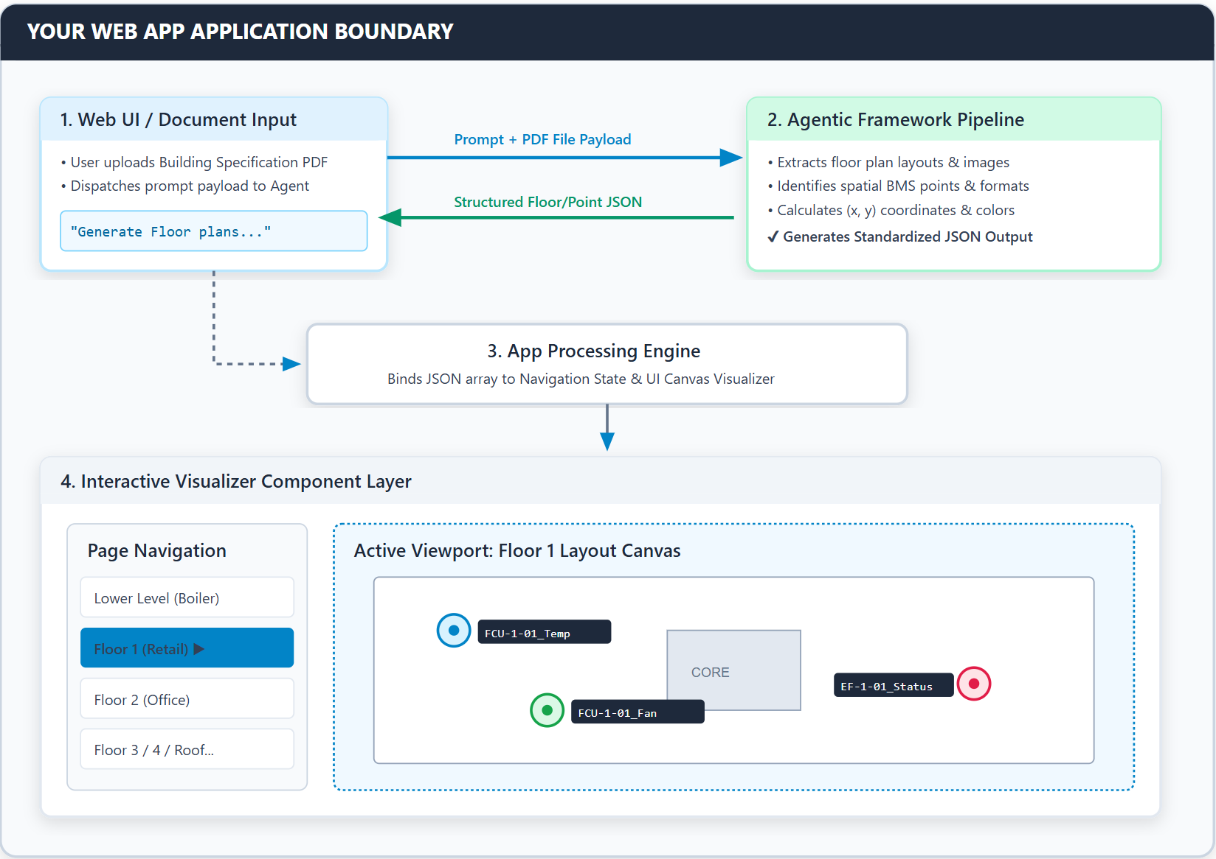

Slide 7
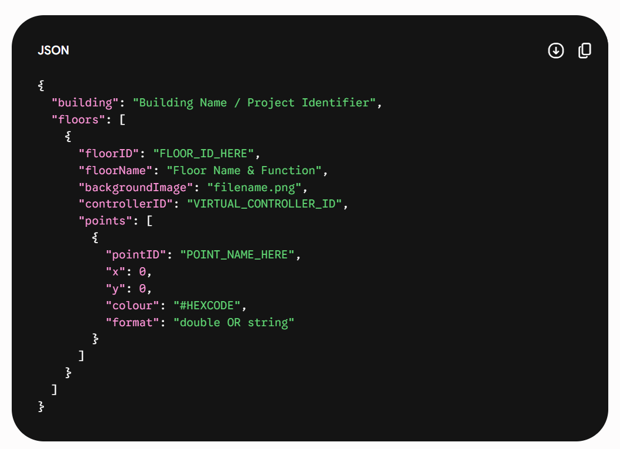
Suggested JSON Schema for Hackathon Agents

Slide 8
Scoring
Points will be awarded for designing the system for extension and functionality.
Design specialized agents.
Do not concern yourself with optimisation.
Focus entirely on quality of the generated image and JSON.
Does not have to talk to real systems like Trend, Alerton, Niagara

Slide 9
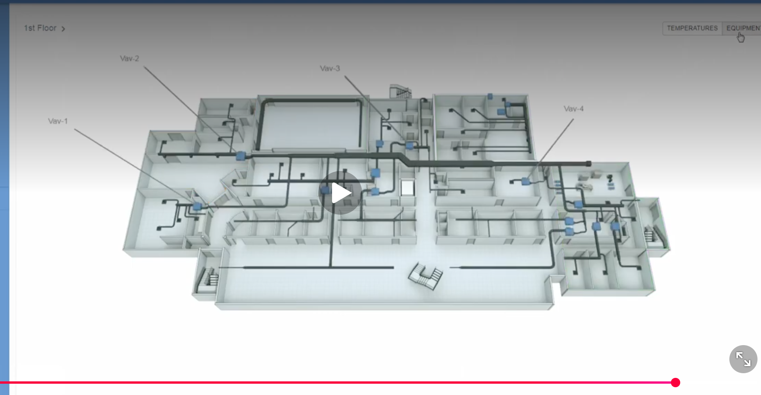
Ideas galery

Slide 10
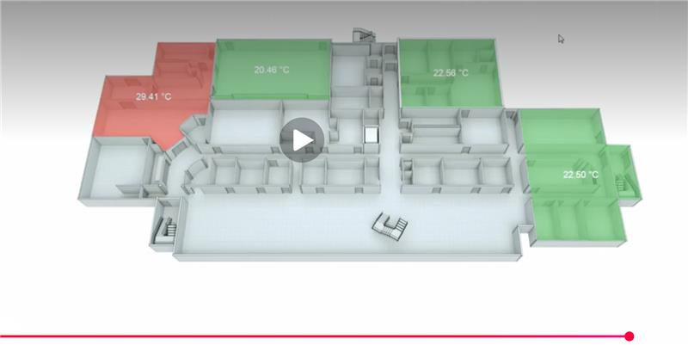

Slide 11
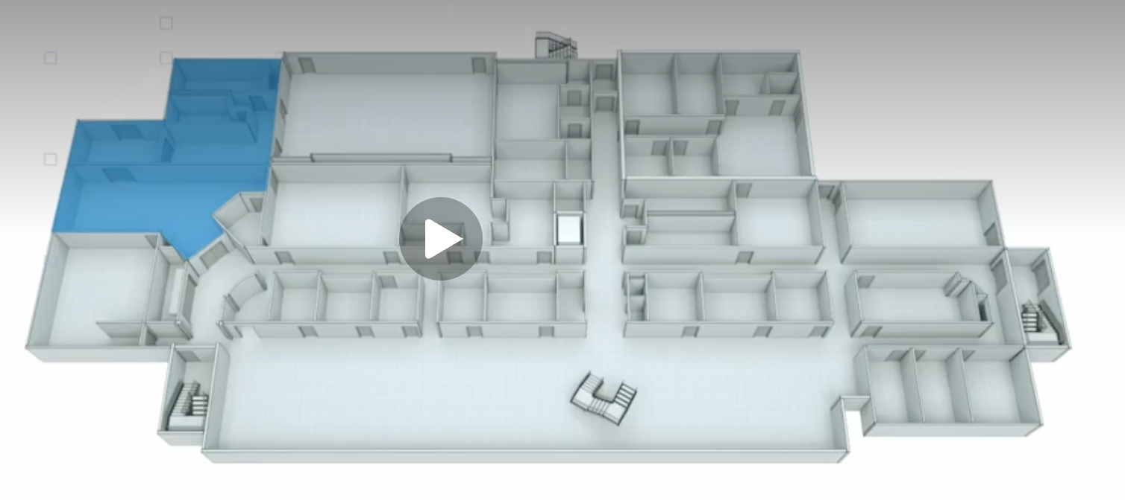

Slide 12
https://www.gramoll.com/wp-content/uploads/2018/10/USU-ASPIRE-EVR-BID-DRAWINGS-20230307.pdf
https://www.cambuilds.com/wp-content/uploads/2017/06/MEP-Holabird-Bid-Set-Drawings.pdf
https://www.google.com/search?q=tridium+floorplan+graphic&rlz=1C5GCEM_enUS1186US1186&oq=tridium+flo…

